Slide 1
SER 334 A Session
SI Session
Sunday, January 21st 2024
7:00 pm - 8:00 pm MST

Slide 2
{
Agenda
Macros
Function Parameters
BMP File Format
Reading Contents
Headers

Slide 3
SI Session Expectations
Thanks for coming to the SER 334 SI session. We have a packed agenda and we are going to try to get through as many of our planned example problems as possible. This session will be recorded and shared with others.
If after this you want to see additional examples, please visit the drop-in tutoring center.
We will post the link in the chat now and at the end of the session.
tutoring.asu.edu
Please keep in mind we are recording this session and it will be made available for you to review 24-48 hours after this session concludes.
Finally, please be respectful to each other during the session.

Slide 4

Interact with us:
Zoom Features
Zoom Chat
Use the chat feature to interact with the presenter and respond to presenter’s questions.
Annotations are encouraged

Slide 5
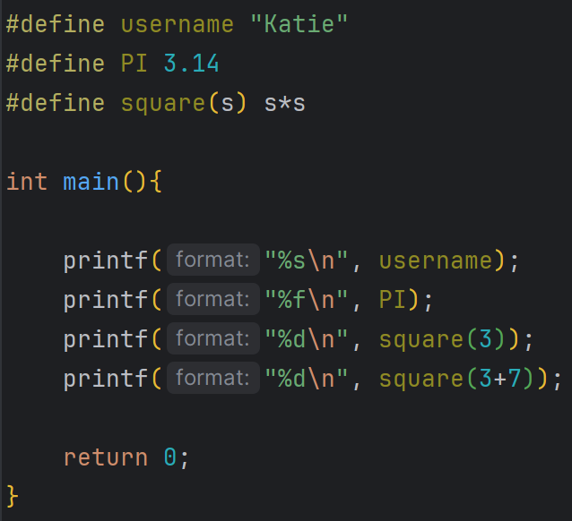
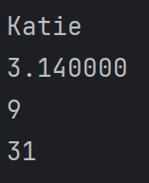
Very helpful BUT we need to be careful
SER 334
Macros
?
How can we solve this?
Notes:
Why?
Direct substitution!

Slide 6


SER 334
Parameters
Both functions will perform the same task
BUT there is a big difference in implementation

Slide 7
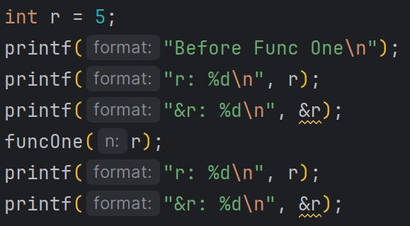
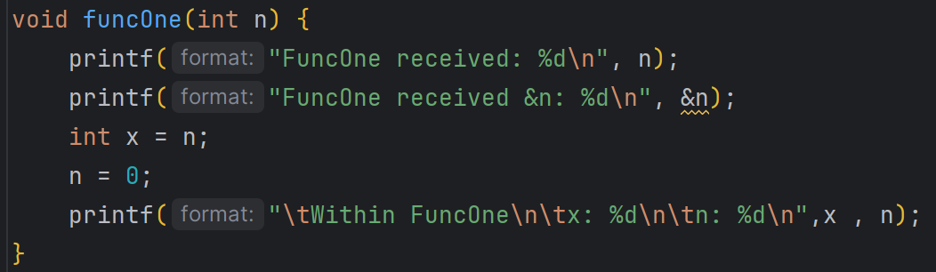
SER 334
Parameters
Standard Pass-By-Value, same as we have before.
Notes:
Same or different?? - different bc we make a copy
5 or zero?? - 5 bc we only updated the copy

Slide 8
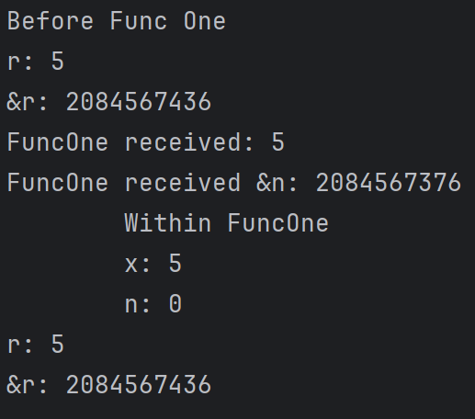
SER 334
Parameters
Standard Pass-By-Value, same as we have before.
Will this be the same address as r?
Notes:
Same or different?? - different bc we make a copy
5 or zero?? - 5 bc we only updated the copy

Slide 9
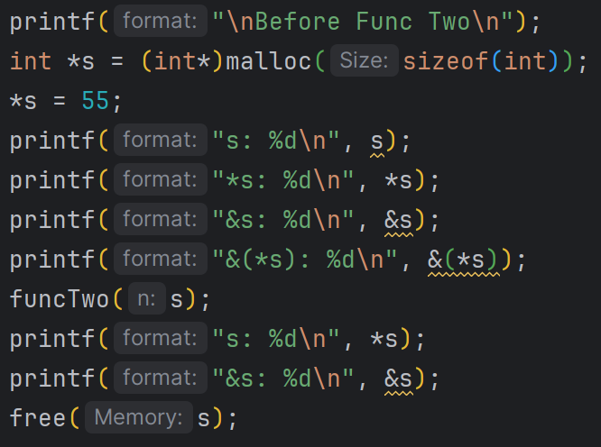
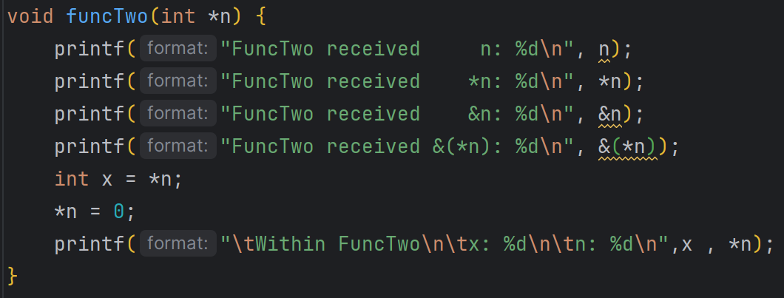
0x5
55
SER 334
Parameters
0x88
s
0x5
Missing something here?
Pass-By-Value, using a pointer.
Notes:
First - what are we missing??

Slide 10
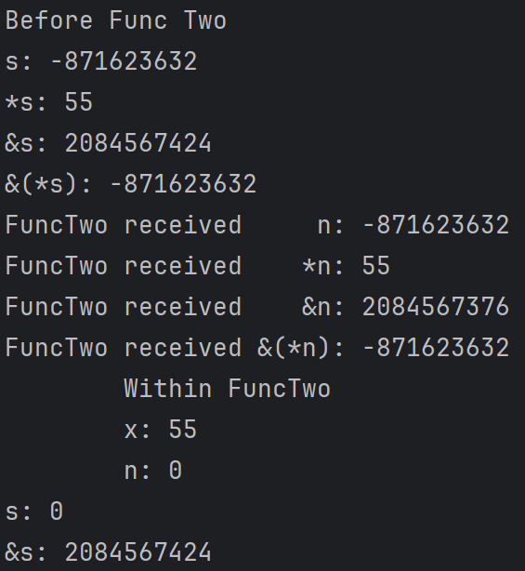
SER 334
Parameters
Pass-By-Value, using a pointer.
Notes:
First - what are we missing??

Slide 11
0x5
55
SER 334
Parameters
0x88
s
0x5
Pass-By-Value, using a pointer.
Notes:
First - what are we missing??

Slide 12
0x3632
55
SER 334
Parameters
0x7424
s
0x3632
Pass-By-Value, using a pointer.
Notes:
First - what are we missing??

Slide 13
0x3632
55
SER 334
Parameters
0x7424
s
0x3632
0x7376
n
0x3632
Pass-By-Value, using a pointer.
Notes:
First - what are we missing??

Slide 14
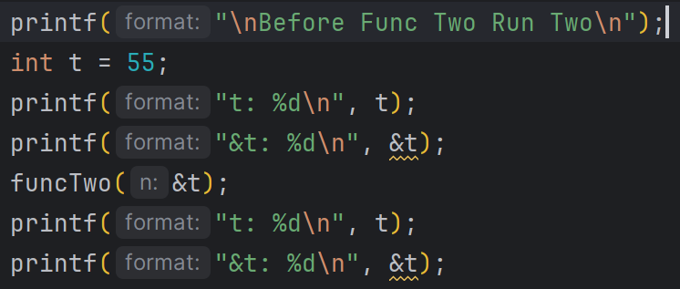
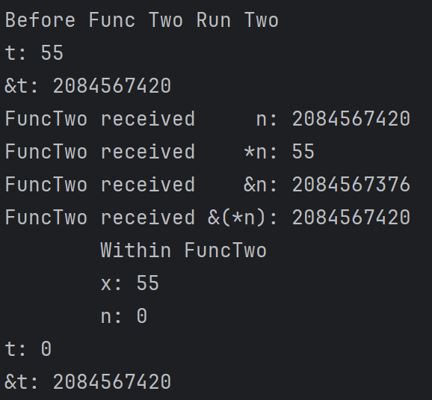
SER 334
Parameters
Sent the location of the variable!
Also notice that we are using a normal int and not a pointer!
Same Function, but Pass-By-Reference
Notes:
Why pass by reference?

Slide 15
SER 334
Parameters
Sent the location of the variable!
0x7420
t
55
Notes:
Why pass by reference?

Slide 16
SER 334
Parameters
Sent the location of the variable!
0x7420
t
55
0x7420
n
55
Notes:
Why pass by reference?

Slide 17

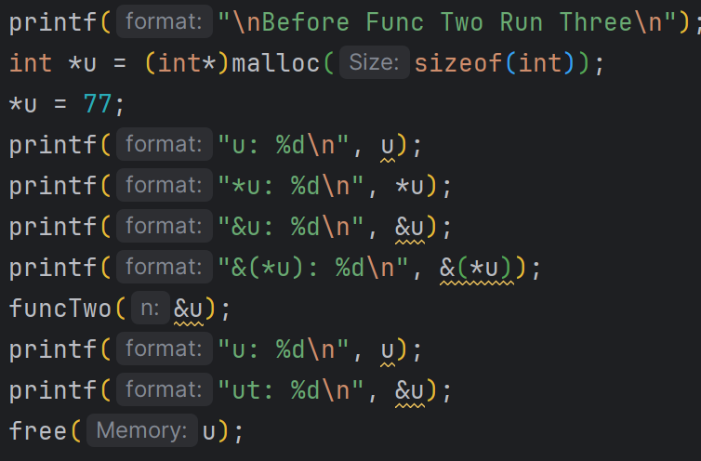
SER 334
Parameters
What about sending the location of a pointer? Any ideas?
Sent the location of the variable!
🤔
0x7420
t
55
0x7376
n
0x7420
Notes:
Why pass by reference?

Slide 18
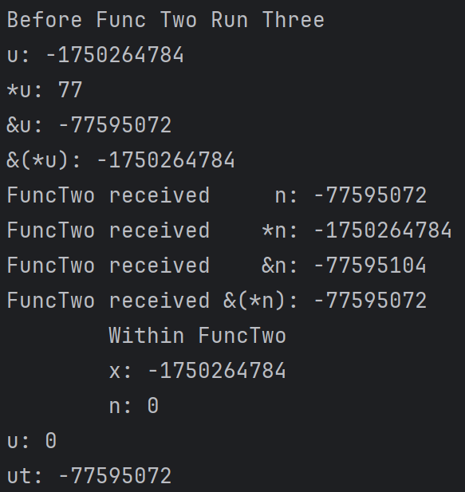
0x4784
77
SER 334
Parameters
0x5072
u
0x4784
0x5104
n
0x5072
Pointer to a pointer - we don’t have the value!
Notes:
First - what are we missing??

Slide 19
Summary
SER 334
Parameters
Makes a local copy
Makes a pointer

Slide 20
Summary
SER 334
Parameters
Makes a local copy
One pointer exists outside of funcTwo, one pointer exists within funcTwo
Integer exists outside of funcTwo, the pointer exists within funcTwo
Pointer
Integer
Makes a new pointer, that is pointing to the same address as the parameter
Makes a new pointer, that is pointing to the same address as the parameter
??

Slide 21
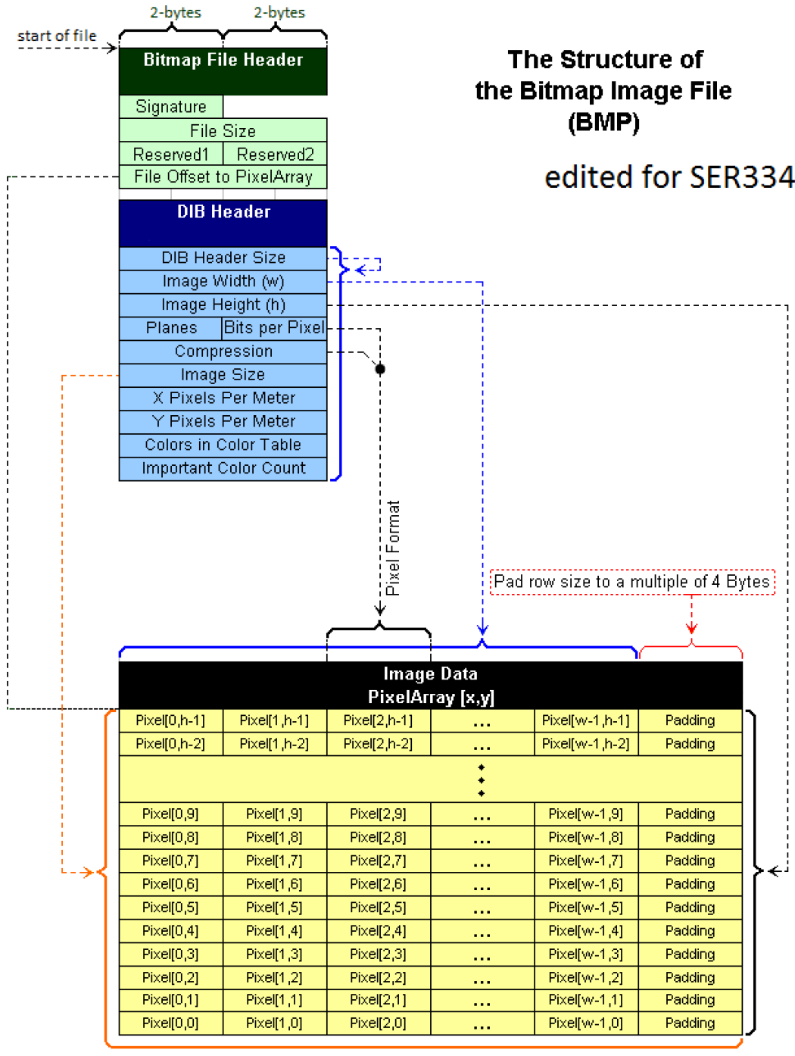
BMP Header Starter Code
SER 334
BMP Format

Slide 22
BMP Header Starter Code
SER 334
BMP Format
DIB Header
BMP Header
Size: 40 bytes
Size: 14 bytes

Slide 23
SER 334
BMP File Format
Remember to account for Endianness!
Big Endian HEX
Little Endian HEX
1
1
0
1
1
0
1
0
1
0
1
0
0
1
1
1
Read L → R
Read R → L
Decimal: 285, 282, 320
Binary: 0001 0001 0000 0001 0001 0000 0001 0000

Slide 24
SER 334
BMP File Format
Remember to account for Endianness!
What is the size of this section?
Big Endian HEX
Little Endian HEX
1
1
1
1
0
0
1
1
1
1
0
0
1
1
0
0
1
0
1
0
0
1
1
1
Read L → R
Read R → L
4 bits
1 byte
Decimal: 285, 282, 320
Binary: 0001 0001 0000 0001 0001 0000 0001 0000
Notes:
4 bits - a nibble

Slide 25
SER 334
BMP File Format
Remember to account for Endianness!
What is the size of this section?
Big Endian HEX
Little Endian HEX
1
1
1
1
0
0
1
1
1
1
0
0
1
1
0
0
1
0
1
0
0
1
1
1
Read L → R
Read R → L
4 bits
1 byte
Decimal: 285, 282, 320
Binary: 0001 0001 0000 0001 0001 0000 0001 0000
Notes:
4 bits - a nibble

Slide 26
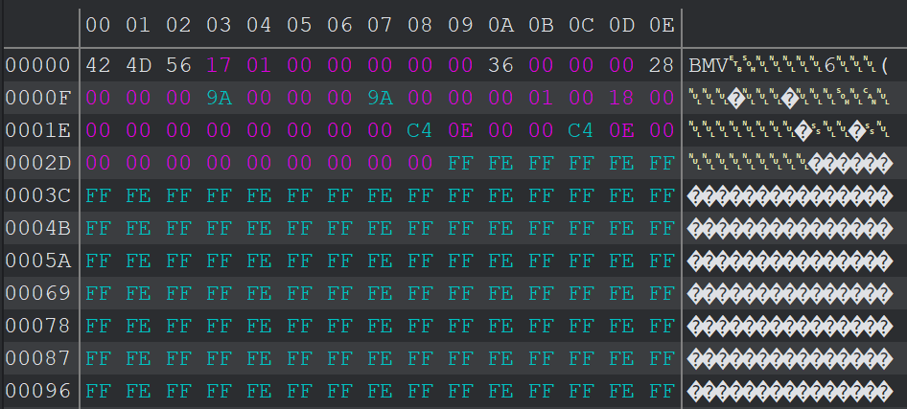
What is this piece?
SER 334
BMP File Format
Notes:
Signature
File size
Reserved 1
Reserved 2
Offset
Header size
Width (in pixels)
Height (in pixels)
Planes
Bits per pixel
Compression
Img size

Slide 27
What is this piece?
SER 334
BMP File Format
Notes:
File size
Reserved 1
Reserved 2
Offset
Header size
Width (in pixels)
Height (in pixels)
Planes
Bits per pixel
Compression
Img size

Slide 28
What is this piece?
SER 334
BMP File Format
Notes:
Reserved 1
Reserved 2
Offset
Header size
Width (in pixels)
Height (in pixels)
Planes
Bits per pixel
Compression
Img size

Slide 29
What is this piece?
SER 334
BMP File Format
Notes:
Offset
Header size
Width (in pixels)
Height (in pixels)
Planes
Bits per pixel
Compression
Img size

Slide 30
What is this piece?
SER 334
BMP File Format
Notes:
Header size
Width (in pixels)
Height (in pixels)
Planes
Bits per pixel
Compression
Img size

Slide 31
What is this piece?
SER 334
BMP File Format
Notes:
Width (in pixels)
Height (in pixels)
Planes
Bits per pixel
Compression
Img size

Slide 32
What is this piece?
SER 334
BMP File Format
Notes:
Height (in pixels)
Planes
Bits per pixel
Compression
Img size

Slide 33
What is this piece?
SER 334
BMP File Format
Notes:
Planes
Bits per pixel
Compression
Img size

Slide 34
What is this piece?
SER 334
BMP File Format
Notes:
Bits per pixel
Compression
Img size

Slide 35
What is this piece?
SER 334
BMP File Format
Notes:
Compression
Img size

Slide 36
What is this piece?
SER 334
BMP File Format
Notes:
Img size
X pix per meter
Y pix per meter
Colors in color table
Important color count

Slide 37
What is this piece?
SER 334
BMP File Format
Notes:
X pix per meter
Y pix per meter
Colors in color table
Important color count

Slide 38
What is this piece?
SER 334
BMP File Format
Notes:
Y pix per meter
Colors in color table
Important color count

Slide 39
What is this piece?
SER 334
BMP File Format
Notes:
Colors in color table
Important color count

Slide 40
What is this piece?
SER 334
BMP File Format
Notes:
Important color count

Slide 41
Upcoming Events
SI Sessions:
Monday, January 22nd at 7:00 pm MST
Sunday, January 28th at 7:00 pm MST Cancelled - good luck on Exam 1!
Monday, January 29th at 7:00 pm MST
Review Sessions:
Exam 1 Review: Thursday, January 25th 7:00 pm - 9:00 pm MST

Slide 42

Questions?
Survey:
http://bit.ly/ASN2324

Slide 43


More Questions?
Check out our other resources!
tutoring.asu.edu
1-
2-
Click on ‘Go to Zoom’ to log onto our Online Tutoring Center.
Click on ‘View the tutoring schedule’ to see when tutors are available for specific courses.

Slide 44
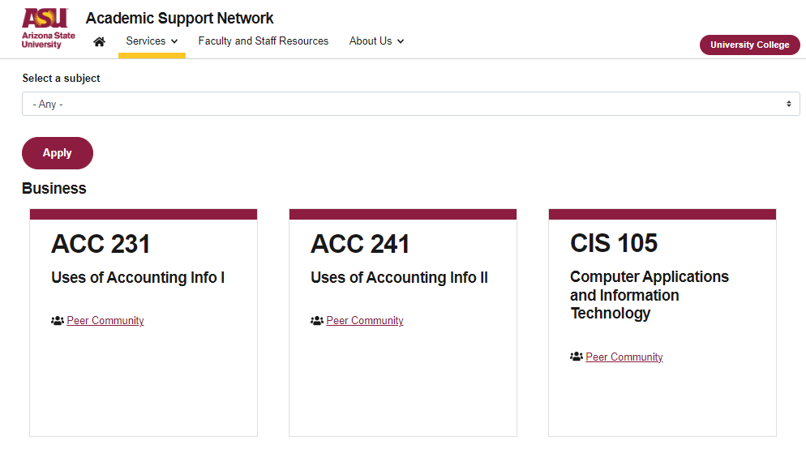

More Questions?
Check out our other resources!
tutoring.asu.edu/online-study-hub
Don’t forget to check out the Online Study Hub for additional resources!

Slide 45
Additional Resources
Course Repo
BMP File Format (Wiki)
Linux Kernel API

